Slide 1

EMAIL SPAM CLASSIFIER PROJECT
Submitted by:
VijaySingh Pardeshi

Slide 2
Introduction
You were recently hired in a Start-up Company and was asked to build a system to identify spam emails. We will explore and understand the process of classifying Emails as Spam or Not Spam by build Machine Learning and NPL model to detect the HAM and SPAM mails. The model will detect the unsolicited and unwanted emails and thus we can prevent them from creeping into user’s inbox and therefore, increase the user Experience.

Slide 3
Problem statement
As we know how a machine translates language, or how voice assistants respond to questions, or how mail gets automatically classified into spam or not spam, all these tasks are done through Natural Language Processing (NLP), which processes text into useful insights that can be applied to future data. In the field of artificial intelligence, NLP is one of the most complex areas of research due to the fact that text data is contextual. It needs modification to make it machine-interpretable and requires multiple stages of processing for feature extraction.

Slide 4
Exploratory Data Analysis
Checking shape of data.
Checking data types of each features using dataframe.info() function.
checking for null values in each column,and treating them.
Pointing out irrelevant features in dataset like ‘id’,unnamed:0’.
Addition of new features to check the length of headline and news before and after preprocessing.
Cleaning the raw data-It involves deletion of words or special characters that do not add meaning to the text.

Slide 5
Exploratory Data Analysis
Important cleaning steps are:
Lowering case
Handling of special characters
Removal of stopwords
Handling of hyperlinks
Removing leading and trailing white space
Replacing urls with web address
Converted words to most suitable base form by using lemmatization

Slide 6
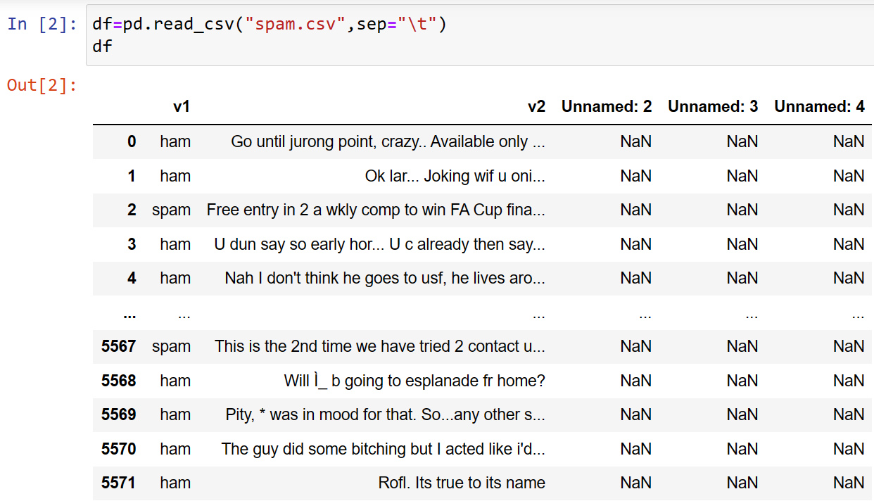
DATA SOURCES AND THEIR FORMATS
The data was provided to us from the Flip Robo Technologies as a part of our Internship assignment. The data was provided in CSV format and there were 5 attributes and 5572 rows in the data set.

Slide 7
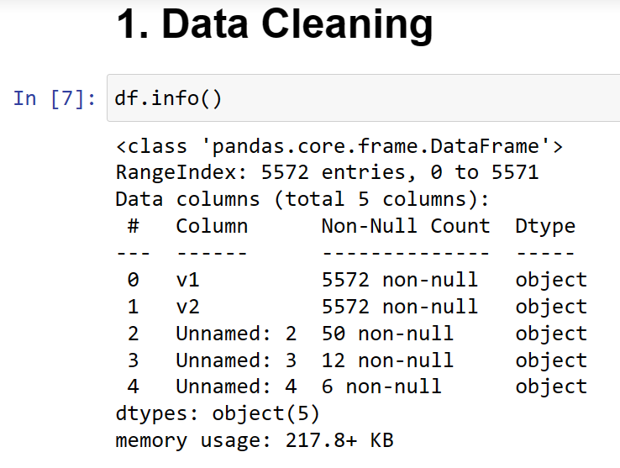
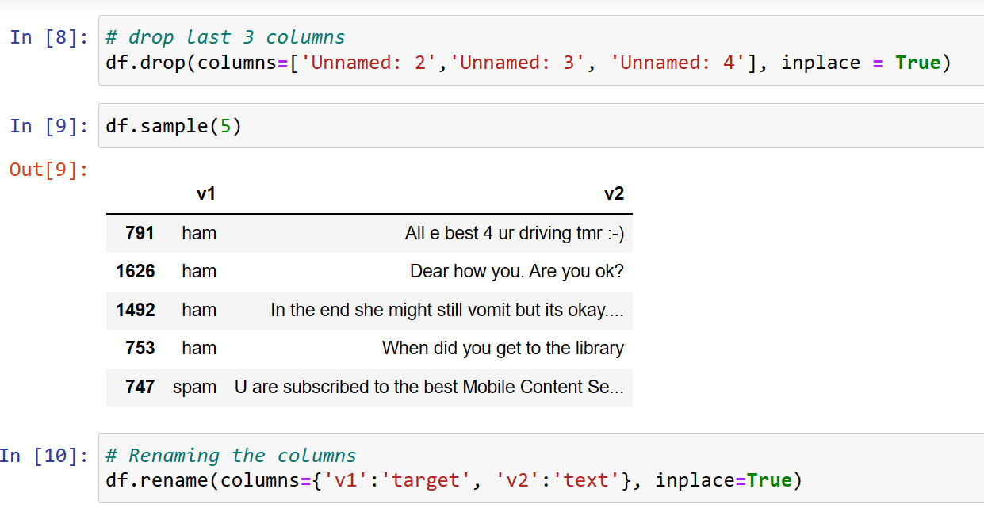
DATA PREPROCESSING:
After loading all the data, we will proceeded with the data pre-processing. Following Steps were followed during data pre-processing:
➢Removing unwanted and renaming attribute from Dataset :
It’s quite hard to find whether a mail is a spam or not just by looking at the subject. So we started by replacing the null values.

Slide 8
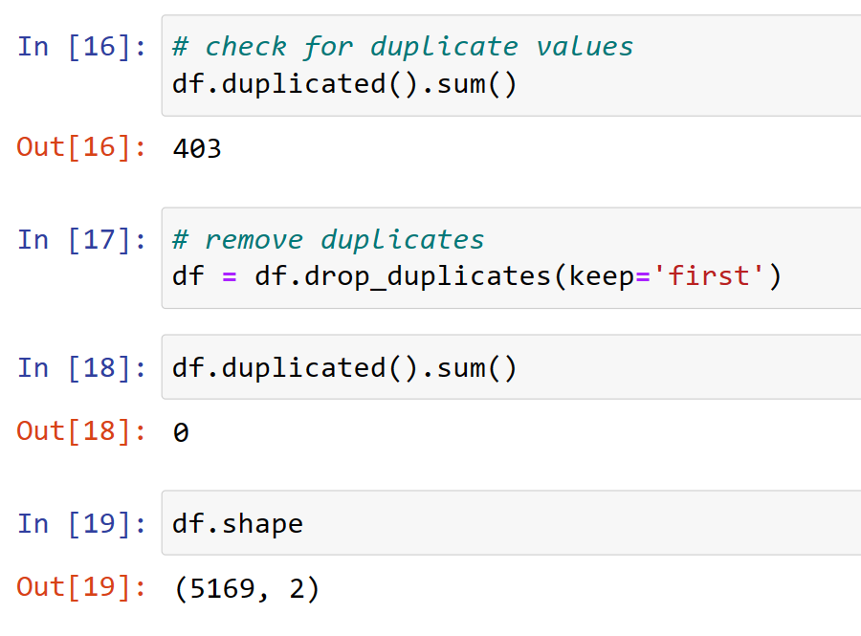
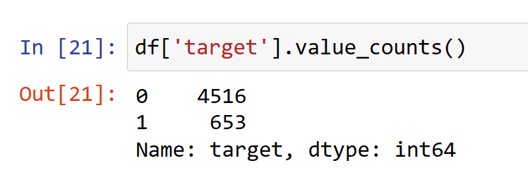
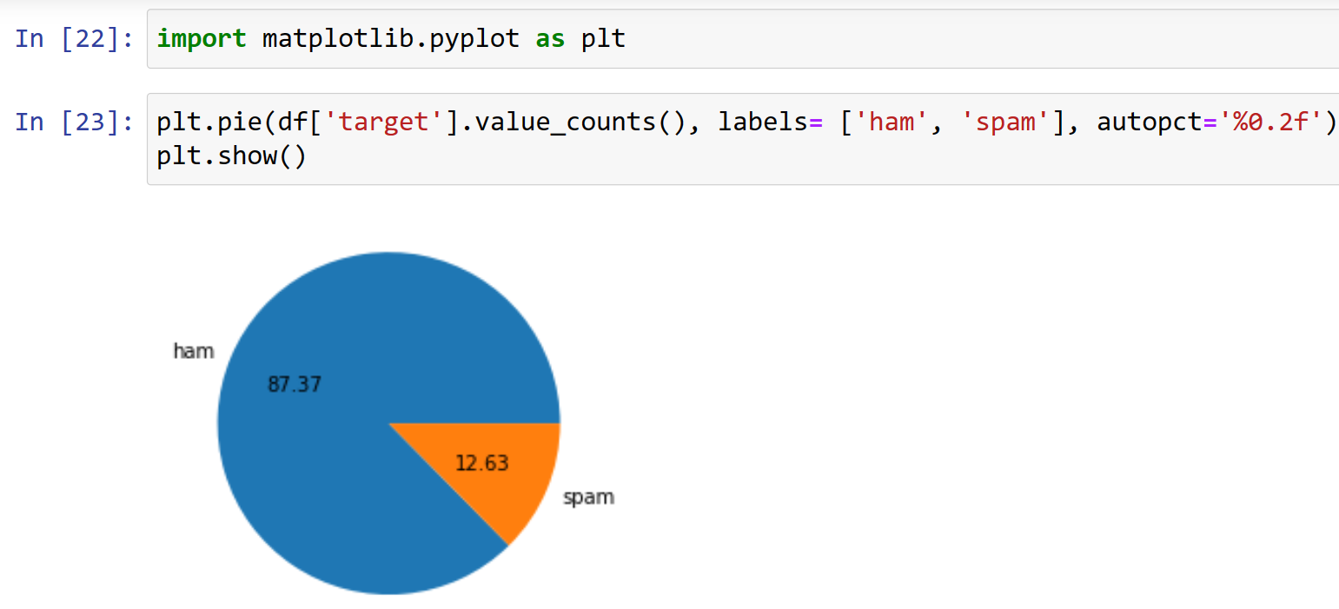
DATA PREPROCESSING:
Remove duplicated values and check value counts of target column

Slide 9
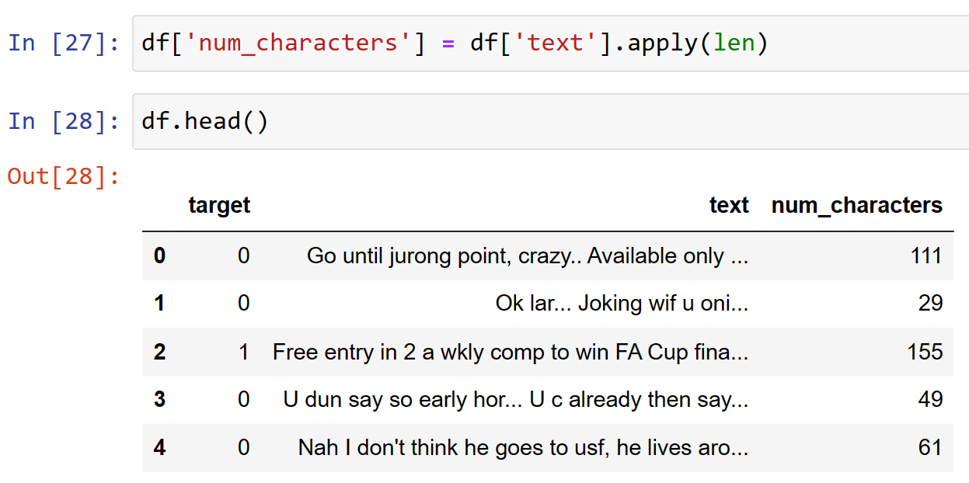
TEXT PREPROCESSING:
Remove duplicated values and check value counts of target column

Slide 10
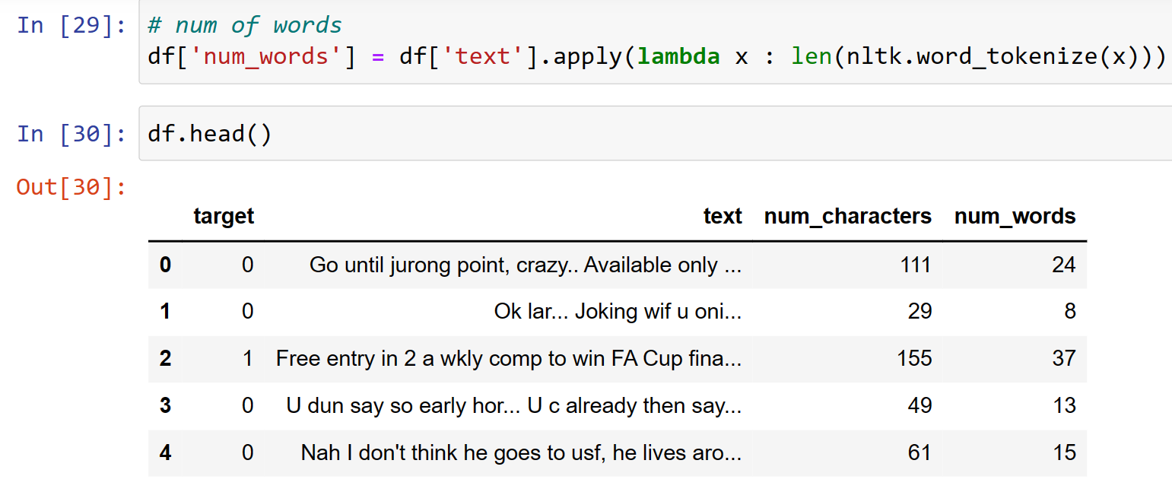
TEXT PREPROCESSING:
Apply tokenize on dataset

Slide 11
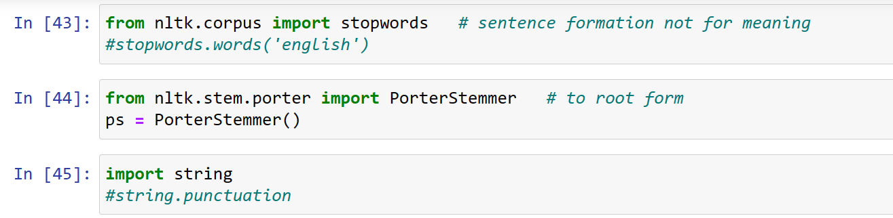
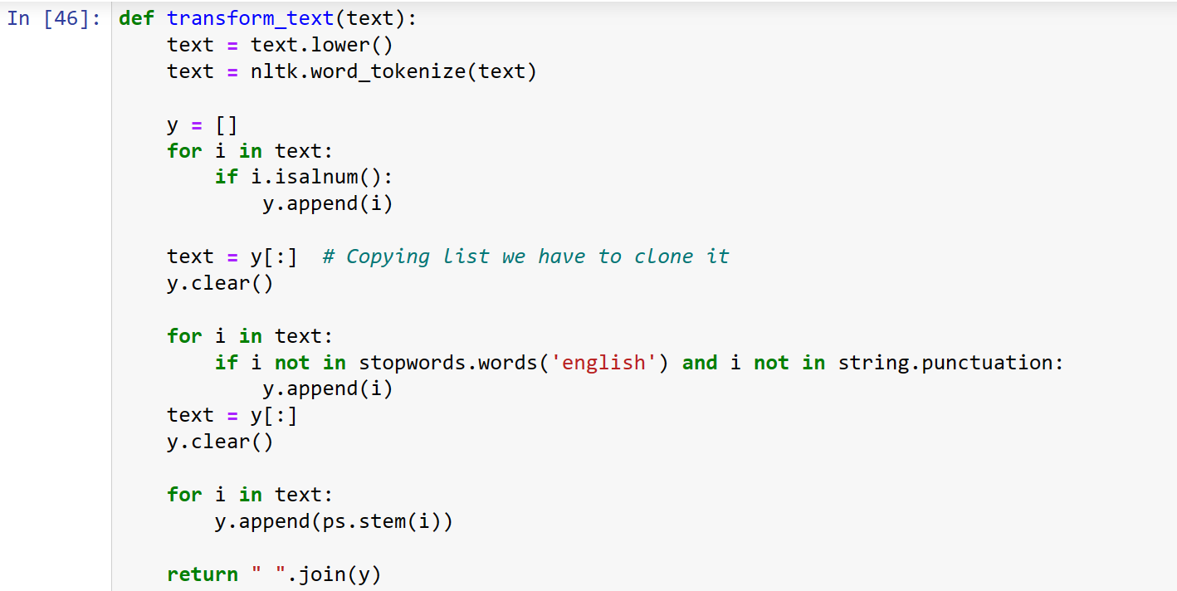
TEXT PREPROCESSING:
Remove stop words and punctuation

Slide 12
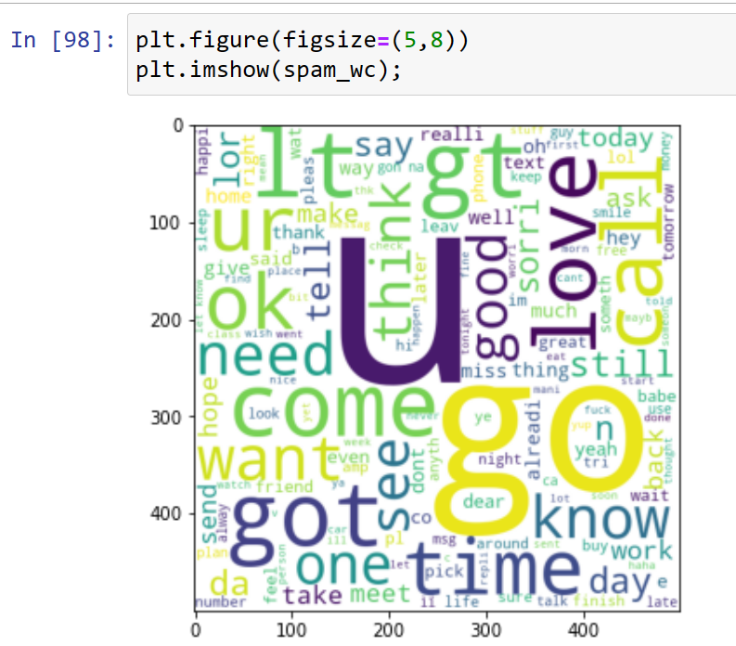
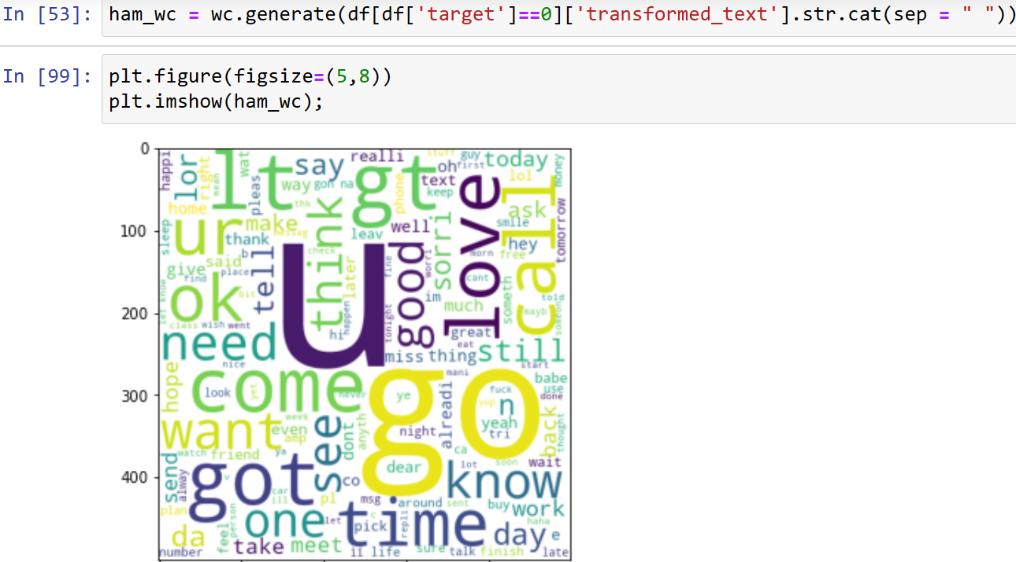
WORD CLOUDS:

Slide 13
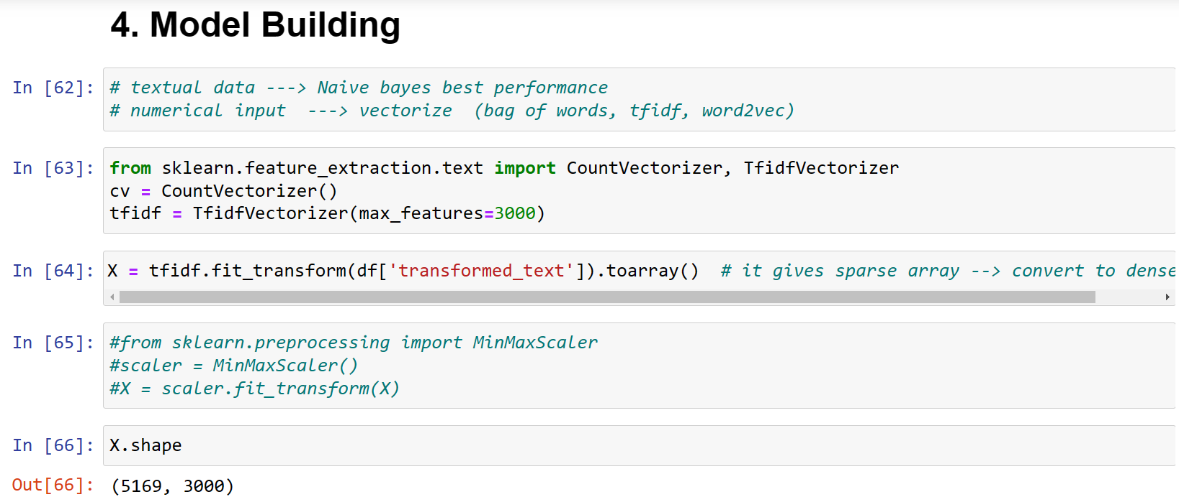
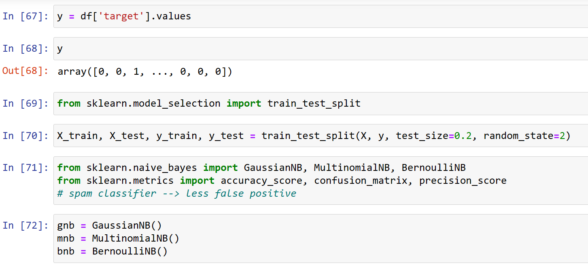
MODEL BUILDING:

Slide 14
Model Building & Performance
it’s a binary classification type problem and below models were used:
LogisticRegression
DecisionTreeClassifier
RandomForestClassifier
AdaBoostClassifier
MultinomialNB
XGBoost Classifier

Slide 15
Evaluation Matrices
Accuracy - it determines how often a model predicts default and non default correctly. Confusion matrices :It gives direct comparisons of values like True Positives, False Positives, True Negatives and False Negatives
classification report :It displays the precision, recall, F1, and support scores for the model
F1 score - the F1-score, is a measure of a model's accuracy on a dataset. It is used to evaluate binary classification systems, which classify examples into 'positive' or 'negative'. AUC: It represents the degree or measure of separability. It tells how much the model is capable of distinguishing between
Log_Loss:For any given problem, a lower log loss value means better predictions

Slide 16
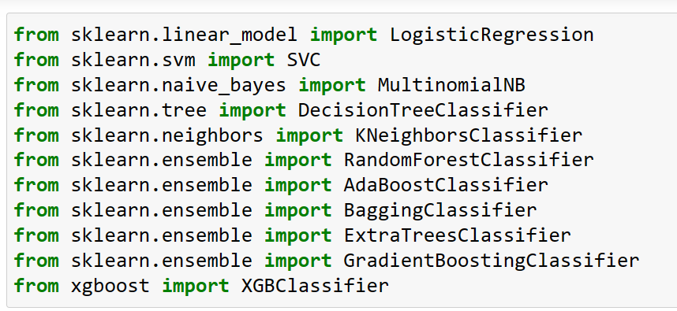
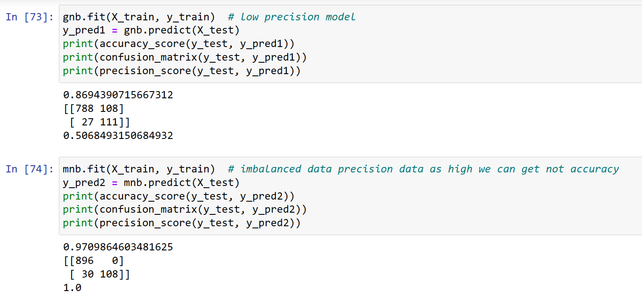
All algorithm by using for loop

Slide 17
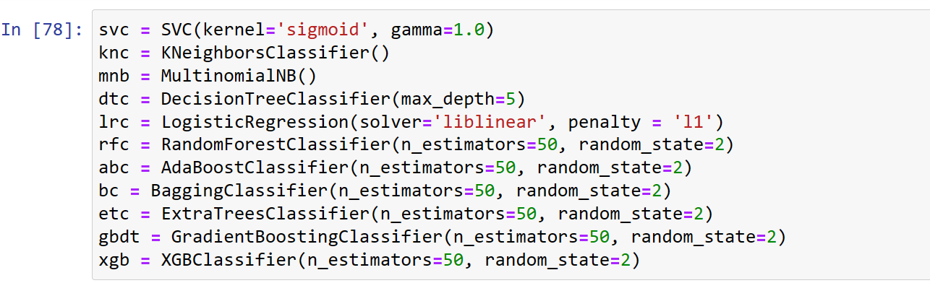
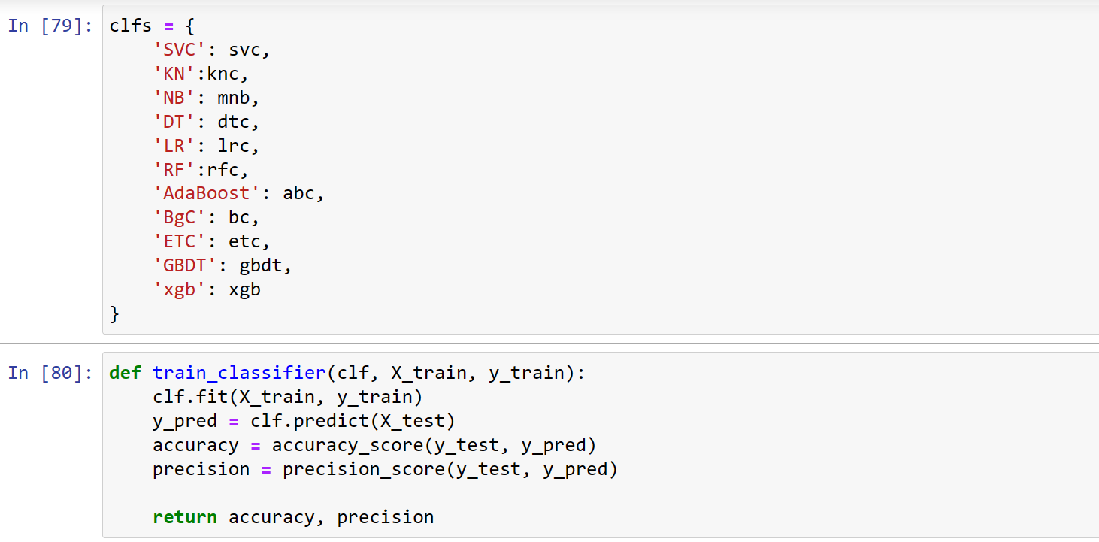
All algorithm by using for loop

Slide 18
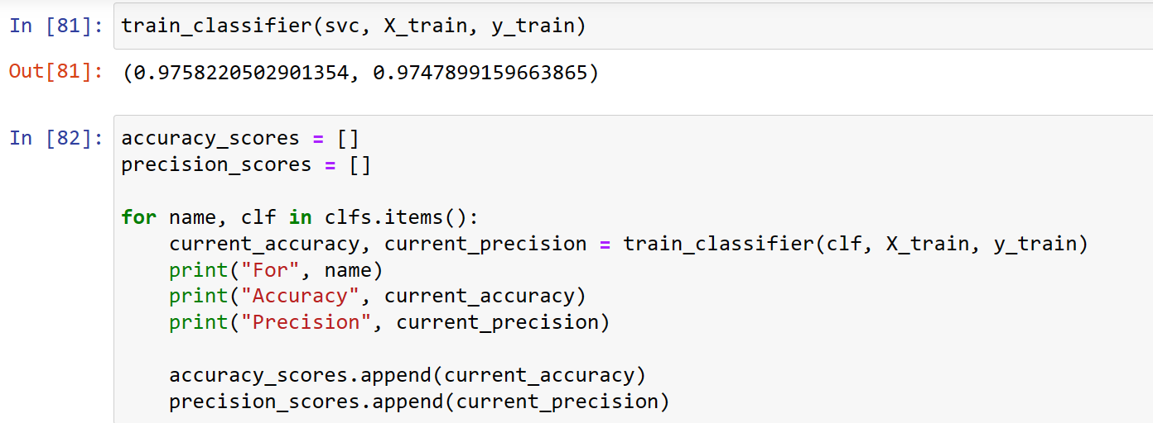
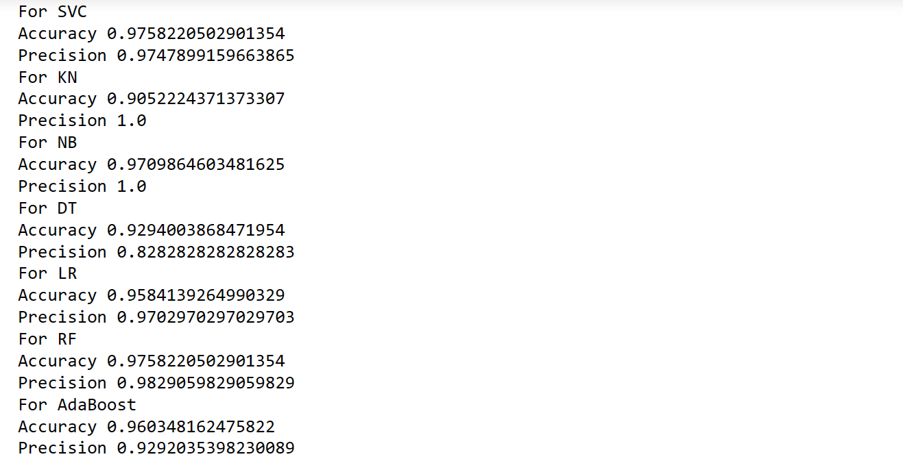
All algorithm by using for loop

Slide 19
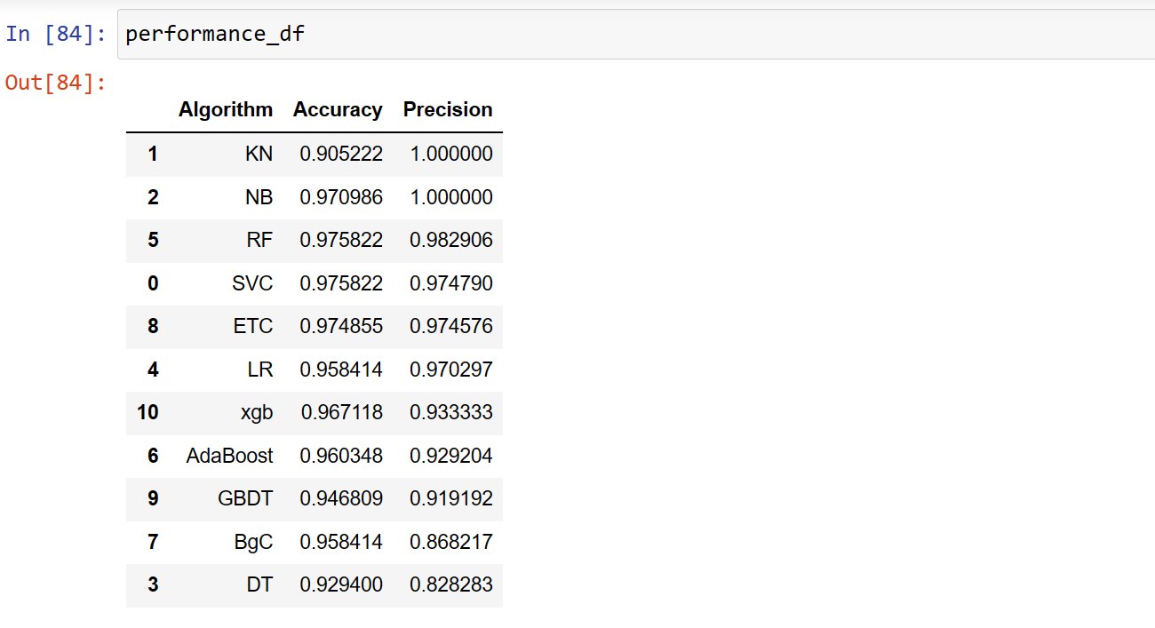
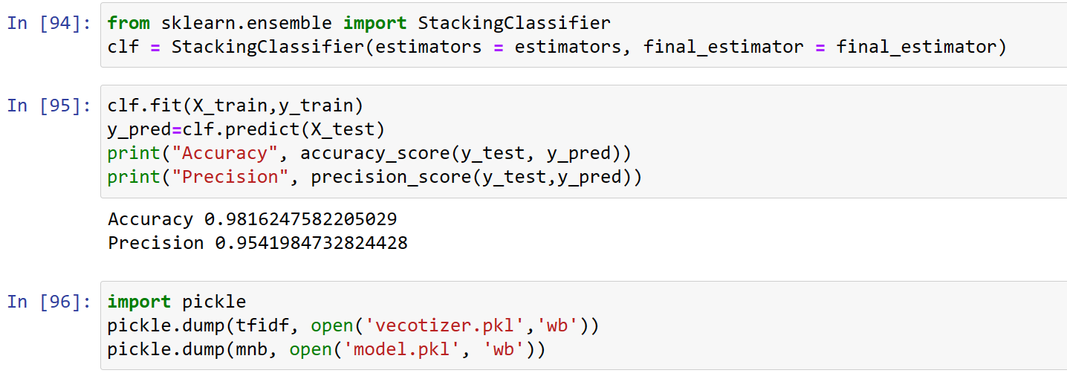

Slide 20
Conclusion
KEY FINDINGS AND CONCLUSIONS OF THE STUDY
From the whole evaluation we found out that the spam emails can be classified and can be stopped doing harm to the users.
LEARNING OUTCOMES OF THE STUDY IN RESPECT OF DATA SCIENCE
I found visualization a very useful technique to infer insights from dataset.
The ROC AUC plot gives large info about the false positive rate and True positive rate at various thresholds.
We are able to classify the emails as spam or non-spam. With high number of emails lots if people using the system it will be difficult to handle all possible mails as our project deals with only limited amount of corpus

